Slide 1

Tiny Shop Sales
Data In Motion
SQL Case Study​
Shruti Pradhan

Slide 2
Introduction
In today’s data-driven world, businesses rely on data analysis to gain insights and make informed decisions.
SQL is a powerful tool that enables us to extract, manipulate, and analyze data stored in relational databases.
In this case study, we’ll explore various SQL queries to analyze customer orders and gain valuable insights for Tiny Shop Sales . Let’s get started!
The challenge is provided by Data in Motion, LLC and link to the dataset is here:
SQL Case Study 1: Tiny Shop Sales .
This case study uses MySQL.
Shruti Pradhan

Slide 3
SQL Topics Required for solving all questions
Basic aggregations
CASE WHEN statements
Window Functions
Joins
LIMIT Clause
CTEs
ROUND, FLOOR, CEIL functions
GROUP BY & ORDER BY clause
Shruti Pradhan

Slide 4
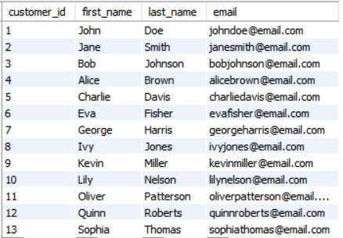
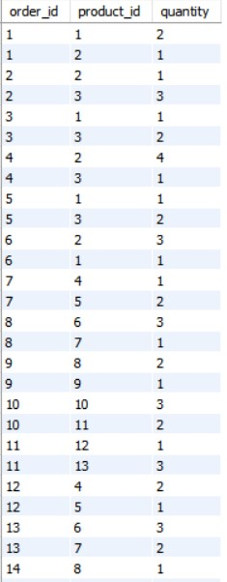
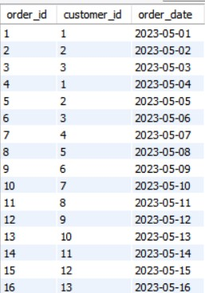
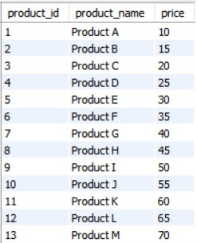
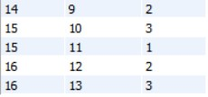
DATASET
customers
orders
products
order_items
Shruti Pradhan

Slide 5
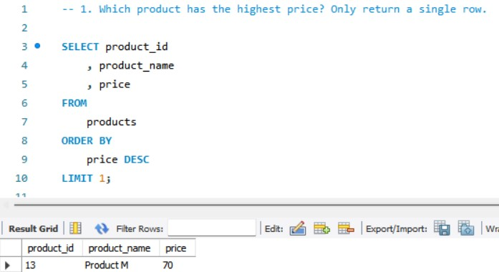
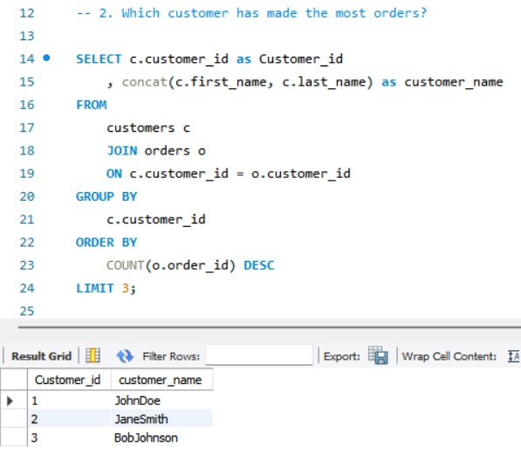
CODE
Shruti Pradhan

Slide 6
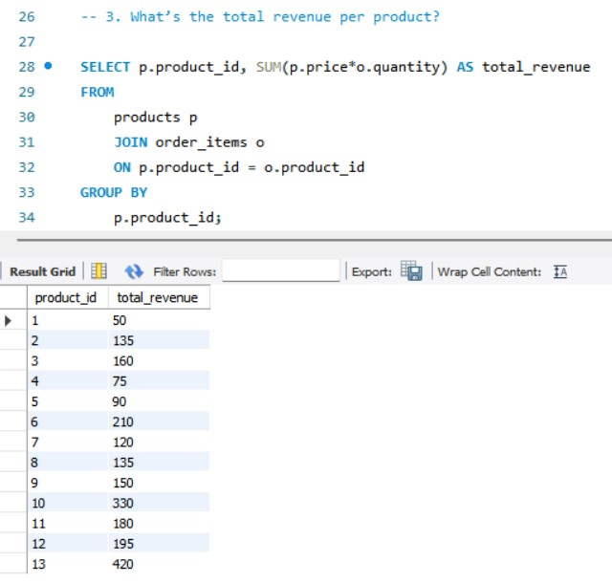
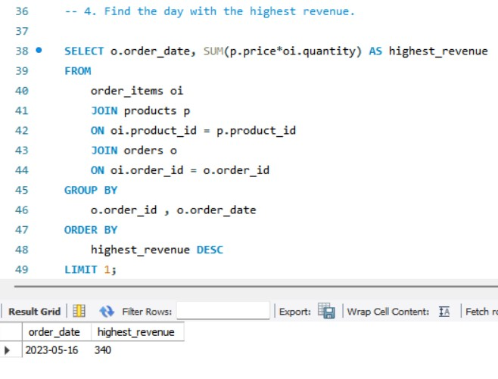
CODE (cont.)
Shruti Pradhan

Slide 7
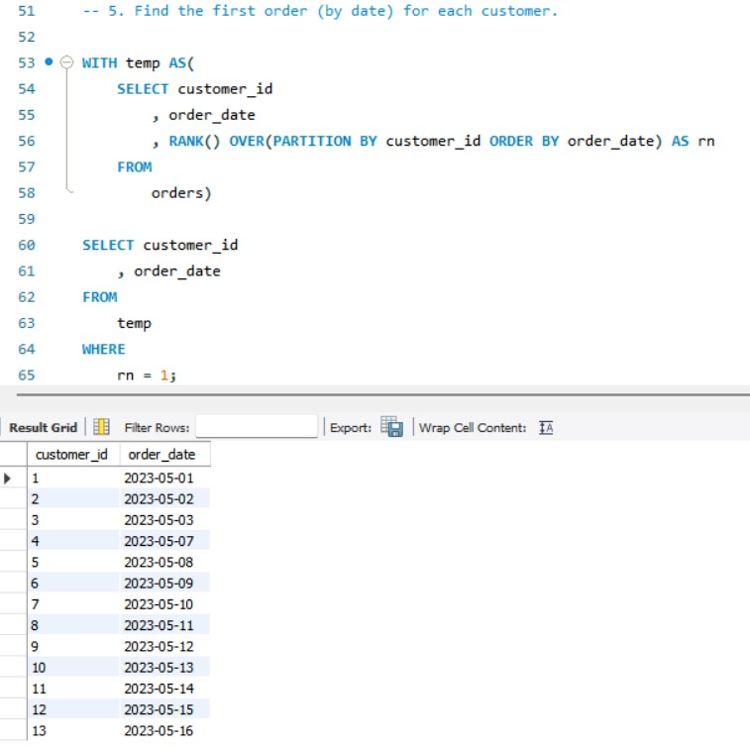
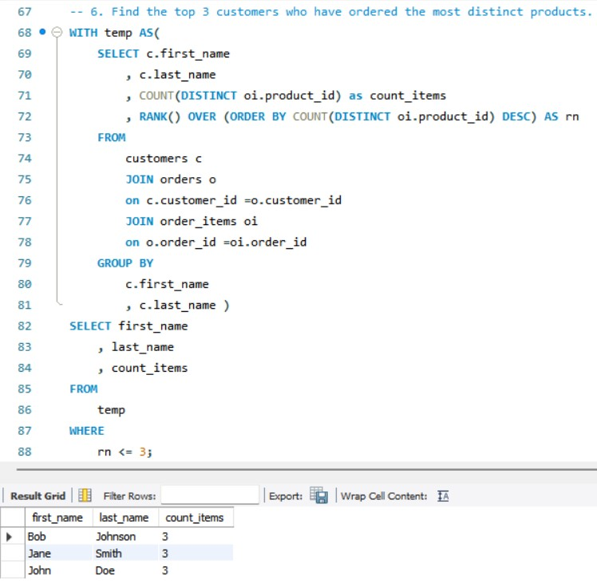
CODE (cont.)
Shruti Pradhan

Slide 8
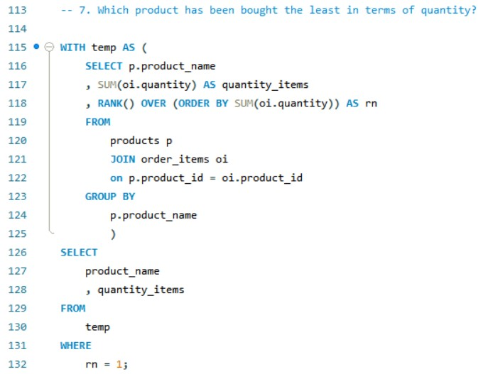
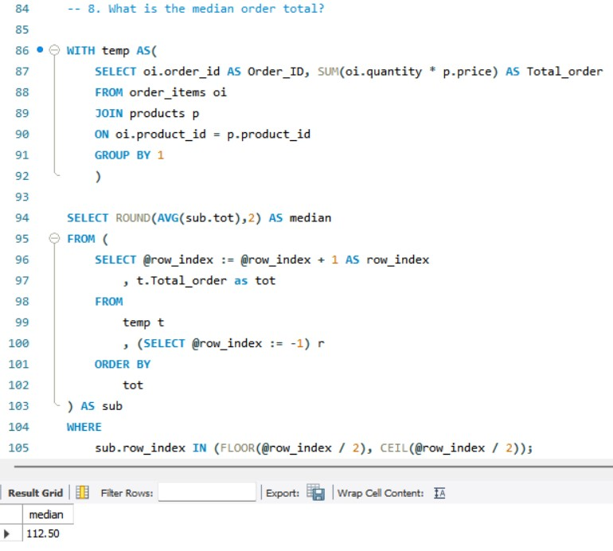
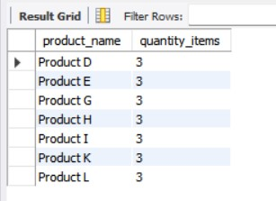
CODE (cont.)
Shruti Pradhan

Slide 9
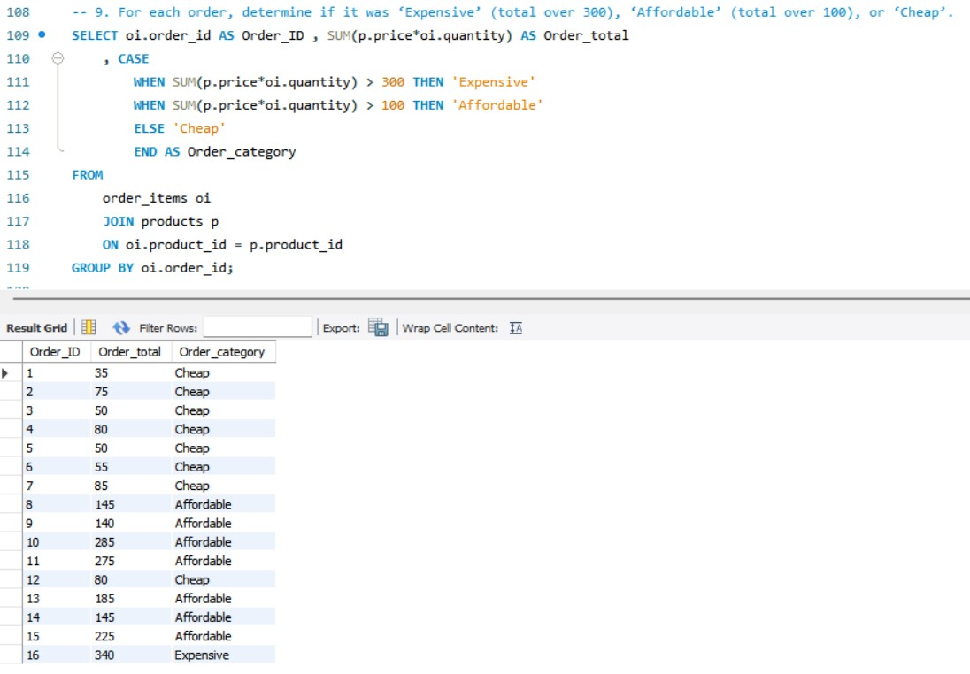
CODE (cont.)
Shruti Pradhan

Slide 10
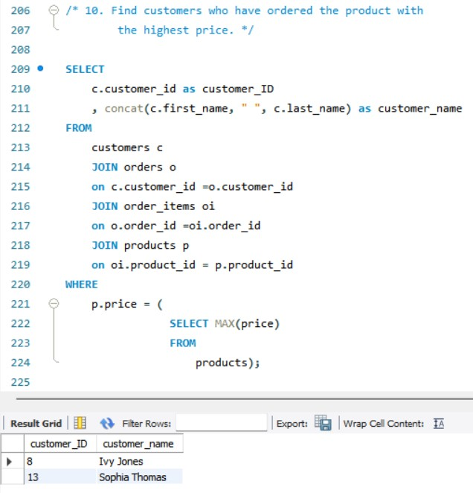
CODE (cont.)
Shruti Pradhan

Slide 11
Insights
The item with the highest price is Product M.
John Doe, Jane Smith and Bob Johnson are the customers who have placed the most orders, in turn making them the most loyal customers.
The order generating the maximum revenue was placed by Sophia Thomas.
May 16, 2023 was recorded as the day that generated the highest revenue for the shop.
Ivy Jones and Sophia Thomas have placed the order for the products bearing the highest price.
Product B has emerged as the most popular product among the shoppers.
The median order total of $112.50 presents a central value, further helping us understand the typical transaction amounts.
Shruti Pradhan

Slide 12
THANK YOU
Happy
SQL-ing!!!
Shruti Pradhan

